Slide 1
Dynamic programming: 0/1 knapsack
Session 16
Henry Lucky, S.Kom., M.Kom.

Slide 2
Learning Outcomes
Session 16
This session addresses:
LO1: Evaluate the time and space complexity of algorithms using asymptotic notation and formal analysis methods, and prove algorithm correctness using loop invariants, induction, or exchange arguments.
LO3: Design solutions to unfamiliar computational problems by selecting and applying appropriate strategies including Divide and Conquer, Greedy, Dynamic Programming, and Backtracking.

Slide 3
Learning Outcomes
Session 16
By the end of this session, students will be able to:
LO 1 – Evaluate pseudo-polynomial O(nW) vs. polynomial complexity for 0/1 Knapsack; explain why O(nW) is not polynomial in the input size; analyze rolling-array space optimization to O(W).
LO 3 – Design the 2D DP table for 0/1 Knapsack; implement top-down memoization and bottom-up tabulation; reconstruct the optimal item set from the table.

Slide 4
outline
Session 16
0/1 Knapsack Problem Formulation
Dynamic Programming Approaches
Reconstructing the optimal item set
Space Optimization — Rolling Array Technique

Slide 5
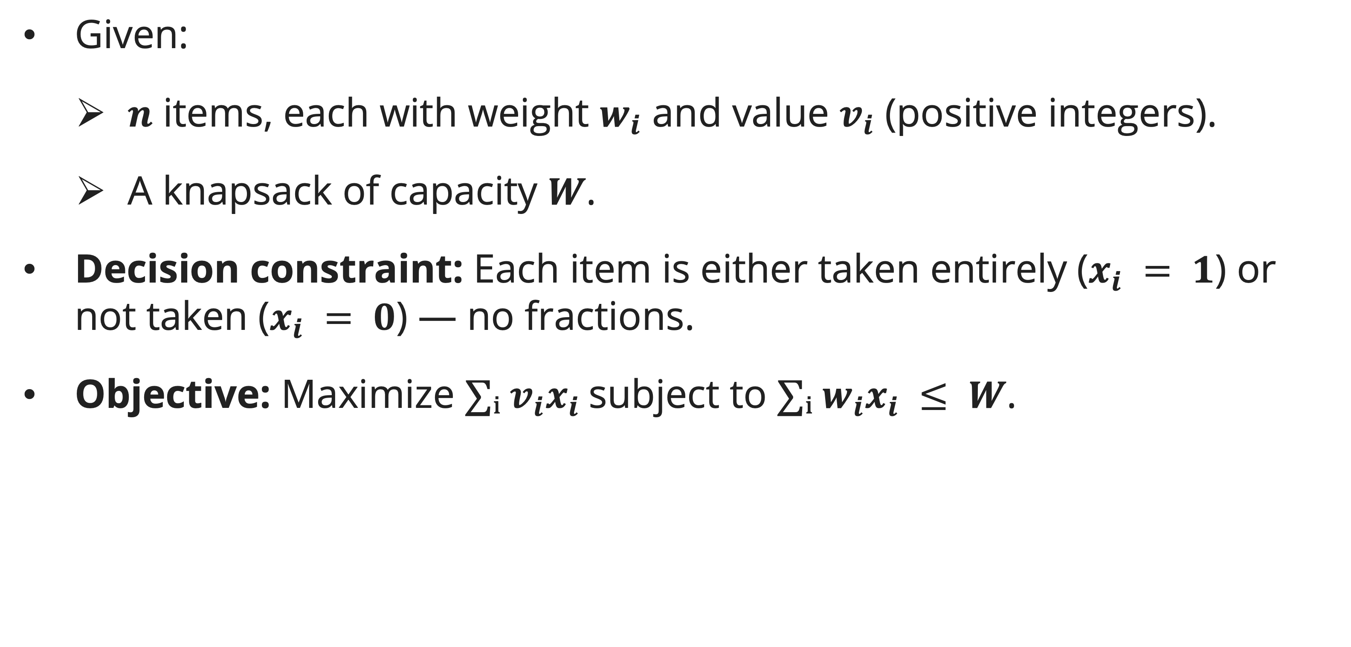
0/1 Knapsack Problem Formulation
Problem definition
Given:
  $n$ items, each with weight $w_{i}$ and value $v_{i}$ (positive integers).
  A knapsack of capacity $W$.
Decision constraint: Each item is either taken entirely ($x_{i} = 1$) or not taken ($x_{i} = 0$) — no fractions.
Objective: Maximize $∑ᵢ v_{i}x_{i}$subject to $∑ᵢ w_{i}x_{i} ≤ W$.

Slide 6
0/1 Knapsack Problem Formulation
Why greedy fails
Counterexample: W = 50, items: (wᵢ, vᵢ) = (10, 60), (20, 100), (30, 120).
Value densities: 60/10=6, 100/20=5, 120/30=4.
Fractional greedy: take all of item 1 (60), all of item 2 (100), 20/30 of item 3 → total = 60+100+80 = 240.
0/1 greedy (take highest density first): take item 1 (10,60) + item 2 (20,100) = total value 160, weight 30 ≤ 50. Could also take item 3 (30,120): 10+20+30=60>50; no. Take item 1+3: 10+30=40≤50, value=60+120=180. Take item 2+3: 20+30=50≤50, value=100+120=220. Greedy by density gives 160; optimal is 220.

Slide 7
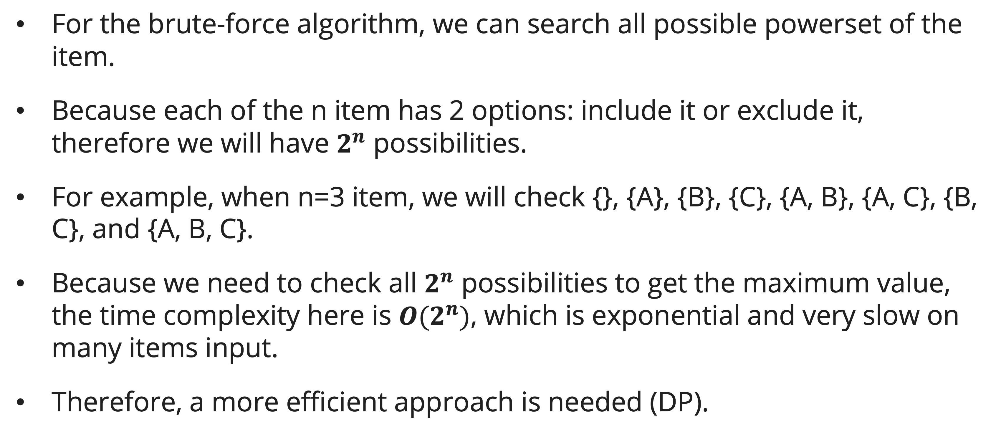
0/1 Knapsack Problem Formulation
The brute-force algorithm
For the brute-force algorithm, we can search all possible powerset of the item.
Because each of the n item has 2 options: include it or exclude it, therefore we will have $2^{n}$ possibilities.
For example, when n=3 item, we will check {}, {A}, {B}, {C}, {A, B}, {A, C}, {B, C}, and {A, B, C}.
Because we need to check all $2^{n}$ possibilities to get the maximum value, the time complexity here is ${O(2}^{n})$, which is exponential and very slow on many items input.
Therefore, a more efficient approach is needed (DP).
Notes:
The Binary Choice Rule
For any item, there are only 2 options:
0: Leave the item out.
1: Put the item in.
If you have n items, you multiply the number of choices for each item together: 2x2x2x…x2=2^n

Slide 8
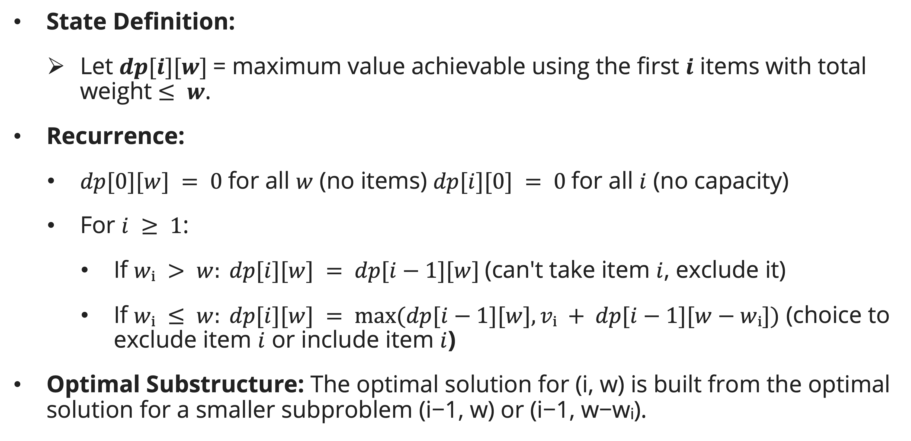
Dynamic programming approaches
DP Formulation
State Definition:
  Let $dp[i][w]$= maximum value achievable using the first $i$ items with total weight $≤ w$.
Recurrence:
  $dp[0][w] = 0$for all $w$ (no items) $dp[i][0] = 0$for all $i$ (no capacity)
  For $i ≥ 1$:
    If $wᵢ > w: dp[i][w] = dp[i−1][w]$(can't take item $i$, exclude it)
    If $wᵢ ≤ w: dp[i][w] = max⁡(dp[i−1][w], vᵢ + dp[i−1][w−wᵢ])$ (choice to exclude item $i$ or include item $i$)
Optimal Substructure: The optimal solution for (i, w) is built from the optimal solution for a smaller subproblem (i−1, w) or (i−1, w−wᵢ).

Slide 9
Dynamic programming approaches
DP Formulation
Time complexity: O(nW)
Space complexity: O(nW)
KNAPSACK-01(v, w, n, W)
1 Create table dp[0..n][0..W], all zeros
2 for i = 1 to n
3 for c = 0 to W
4 if w[i] > c
5 dp[i][c] = dp[i-1][c]
6 else
7 dp[i][c] = max(dp[i-1][c], v[i] + dp[i-1][c - w[i]])
8 return dp[n][W]

Slide 10
Dynamic programming approaches
Example
Example instance:
  W = 5, items: (w, v) = (2, 6), (2, 10), (3, 12)
Firstly, initialize the table with 0s. Actually we only need the first row and column to be 0 (dp[i][0] for all i and dp[0][c] for all c)
 | c=0 | c=1 | c=2 | c=3 | c=4 | c=5
i=0 | 0 | 0 | 0 | 0 | 0 | 0
i=1 | 0 | 0 | 0 | 0 | 0 | 0
i=2 | 0 | 0 | 0 | 0 | 0 | 0
i=3 | 0 | 0 | 0 | 0 | 0 | 0

Slide 11
Dynamic programming approaches
Example
For every i^{th} item, check for every capacity c, whether to include or exclude the item, starting with i=1.
When i=1, we only consider the first item which is (2, 6), so we can include that item when c = 2 and put the v=6 in the table.
 | c=0 | c=1 | c=2 | c=3 | c=4 | c=5
i=0 | 0 | 0 | 0 | 0 | 0 | 0
i=1 | 0 | 0 | 6 | 6 | 6 | 6
i=2 | 0 | 0 | 0 | 0 | 0 | 0
i=3 | 0 | 0 | 0 | 0 | 0 | 0

Slide 12
Dynamic programming approaches
Example
Continue to consider the 2nd item (i=2). The 2nd item is (2, 10).
At c=2, rather than bringing the 1st item, we should just bring the 2nd item which worth more. This is the v[i] + dp[i-1][c - w[i]] at work.
At c=4, we have enough capacity to bring both 1st and 2nd items.
Note that the same color define dp[i-1][c - w[i]]
 | c=0 | c=1 | c=2 | c=3 | c=4 | c=5
i=0 | 0 | 0 | 0 | 0 | 0 | 0
i=1 | 0 | 0 | 6 | 6 | 6 | 6
i=2 | 0 | 0 | 10 | 10 | 16 | 16
i=3 | 0 | 0 | 0 | 0 | 0 | 0

Slide 13
Dynamic programming approaches
Example
Continue to consider the 3rd item (i=3). The 2nd item is (3, 12).
At c=2, we cannot bring the 3rd item yet because not enough capacity (w[i] > c), but at c=3, we can and it is the most worth item to bring.
At c=4, we exclude 3rd item because 1st and 2nd items has higher value (16 > 12).
At c=5, finally we have enough capacity to bring 2nd and 3rd items to get 22.
 | c=0 | c=1 | c=2 | c=3 | c=4 | c=5
i=0 | 0 | 0 | 0 | 0 | 0 | 0
i=1 | 0 | 0 | 6 | 6 | 6 | 6
i=2 | 0 | 0 | 10 | 10 | 16 | 16
i=3 | 0 | 0 | 10 | 12 | 16 | 22
Notes:
Same color means either dp[i-1][c - w[i]] or dp[i-1][c] here, depends whether w[i] > c

Slide 14
Dynamic programming approaches
Top-down approach
Time: O(nW) each (i, c) pair computed once; Space: O(nW) + O(n) recursion stack
When to prefer top-down: If many (i, c) pairs are never needed (sparse), top-down only computes the needed entries, saving time.
memo = 2D array of -1
KNAPSACK-MEMO(i, c)
1 if i == 0 or c == 0: return 0
2 if memo[i][c] ≠ -1: return memo[i][c]
3 if w[i] > c
4 result = KNAPSACK-MEMO(i-1, c)
5 else
6 result = max(KNAPSACK-MEMO(i-1, c), v[i] + KNAPSACK-MEMO(i-1, c-w[i]))
7 memo[i][c] = result
8 return result

Slide 15
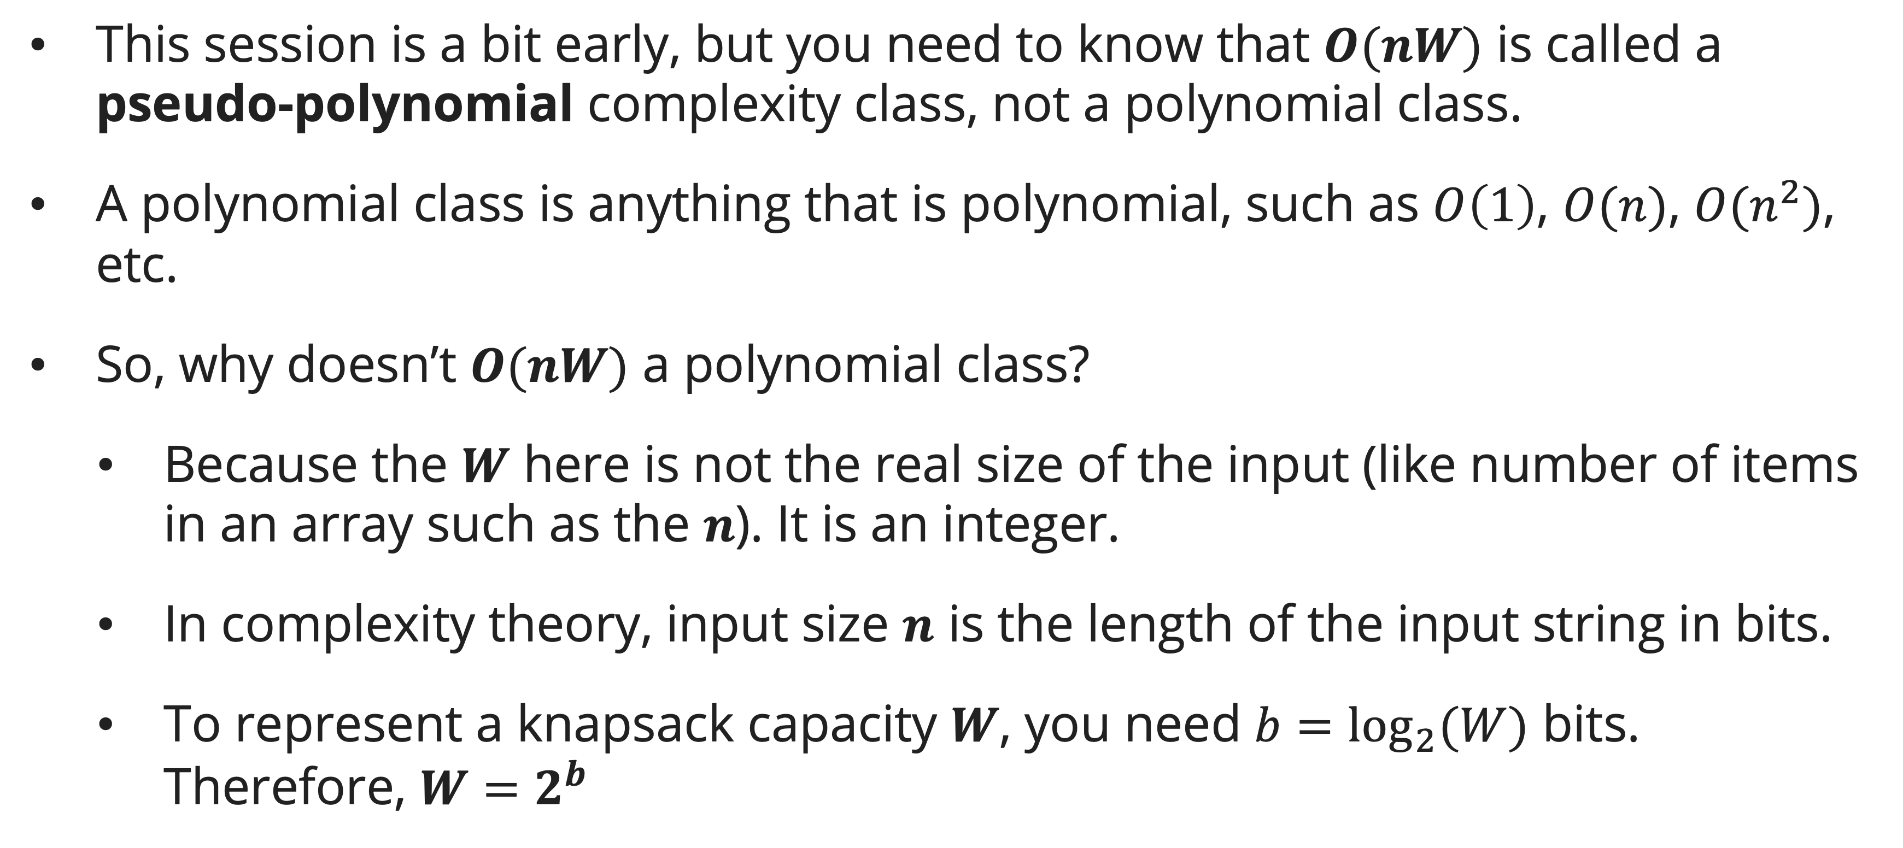
Dynamic programming approaches
On pseudo-polynomial analysis
This session is a bit early, but you need to know that $O(nW)$ is called a pseudo-polynomial complexity class, not a polynomial class.
A polynomial class is anything that is polynomial, such as $O\left(1\right)$, $O(n)$, $O(n^{2})$, etc.
So, why doesn’t $O(nW)$ a polynomial class?
  Because the $W$ here is not the real size of the input (like number of items in an array such as the $n$). It is an integer.
  In complexity theory, input size $n$ is the length of the input string in bits.
  To represent a knapsack capacity $W$, you need $b=\log_{2}⁡(W)$ bits. Therefore, $W=2^{b}$
Notes:
For $b=\log_{2}⁡(W)$ part, remember 32-bit integer stores exactly 2^32 distinct values. So the number of bits needed can be gotten from log base 2 of the integer value.

Slide 16
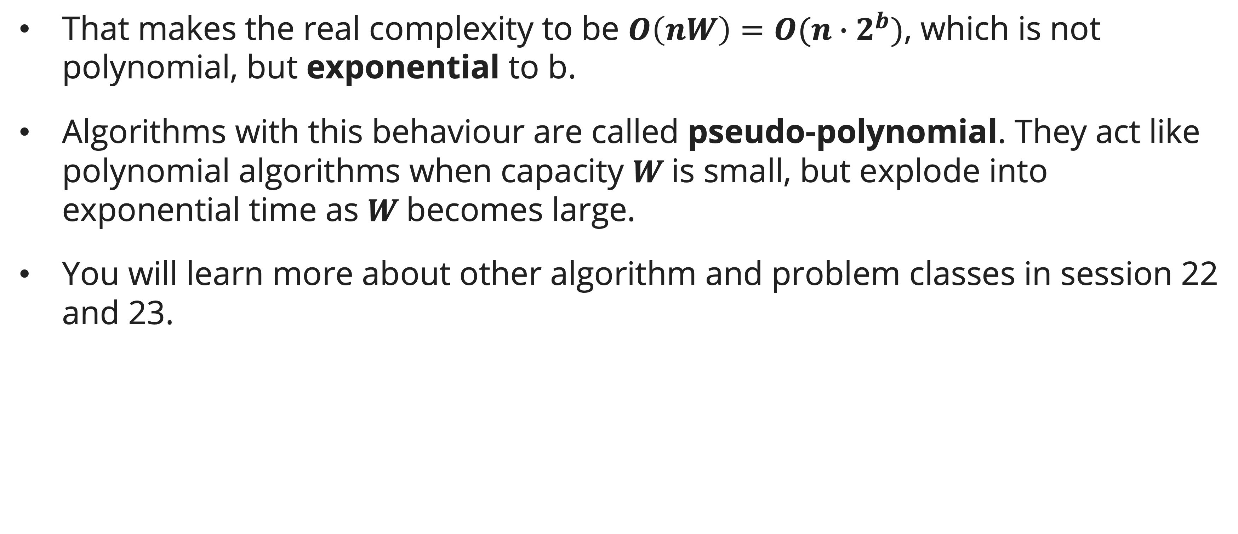
Dynamic programming approaches
On pseudo-polynomial analysis
That makes the real complexity to be $O\left(nW\right)=O(n∙2^{b})$, which is not polynomial, but exponential to b.
Algorithms with this behaviour are called pseudo-polynomial. They act like polynomial algorithms when capacity $W$is small, but explode into exponential time as $W$becomes large.
You will learn more about other algorithm and problem classes in session 22 and 23.
Notes:
For $b=\log_{2}⁡(W)$ part, remember 32-bit integer stores exactly 2^32 distinct values. So the number of bits needed can be gotten from log base 2 of the integer.

Slide 17
Reconstructing the optimal item set
Idea
We have got the optimal value now. What if we also need the exact items that are taken?
The algorithm works by making a choice for each item at each capacity, whether to include or exclude the item.
The idea is to know whenever the algorithm choose to include the item i at certain capacity c, so we can trace it.
If we look closer, whenever the algo choose to include the item i, dp[i][c] will have different value than dp[i-1][c], so we can use this in our pseudocode.

Slide 18
Reconstructing the optimal item set
Pseudocode
RETRACE-01(dp, w, n, W)
1 c = W
2 Create list selected_items, initially empty
3 for i = n down to 1
4 if dp[i][c] != dp[i-1][c]
5 Add i to selected_items
6 c = c - w[i]
7 return selected_items

Slide 19
Reconstructing the optimal item set
Retracement example
 | c=0 | c=1 | c=2 | c=3 | c=4 | c=5
i=0 | 0 | 0 | 0 | 0 | 0 | 0
i=1 | 0 | 0 | 6 | 6 | 6 | 6
i=2 | 0 | 0 | 10 | 10 | 16 | 16
i=3 | 0 | 0 | 10 | 12 | 16 | 22
Start at dp[n][W] at dp[3][5].
Check dp[3][5] != dp[2][5], which is yes, so that mean item 3 is selected.
Go to the next iteration with i=2 and decreasing c by w[3] (3)

Slide 20
Reconstructing the optimal item set
Retracement example
 | c=0 | c=1 | c=2 | c=3 | c=4 | c=5
i=0 | 0 | 0 | 0 | 0 | 0 | 0
i=1 | 0 | 0 | 6 | 6 | 6 | 6
i=2 | 0 | 0 | 10 | 10 | 16 | 16
i=3 | 0 | 0 | 10 | 12 | 16 | 22
We are at dp[2][3] now
Check dp[2][3] != dp[1][3], which is yes, so that mean item 2 is selected.
Go to the next iteration with i=1 and decreasing c by w[2] (2)

Slide 21
Reconstructing the optimal item set
Retracement example
 | c=0 | c=1 | c=2 | c=3 | c=4 | c=5
i=0 | 0 | 0 | 0 | 0 | 0 | 0
i=1 | 0 | 0 | 6 | 6 | 6 | 6
i=2 | 0 | 0 | 10 | 10 | 16 | 16
i=3 | 0 | 0 | 10 | 12 | 16 | 22
We are at dp[1][0] now
Check dp[1][0] != dp[0][0], which is no, so that mean item 1 is not selected.
The iteration ends here as there is no items to be checked next.
Therefore, we have item 2 and item 3 in our knapsack as the optimal item set.

Slide 22
Space Optimization
Space optimization: rolling array
The recurrence dp[i][c] only depends on row i−1, not i-2, i-3, i-4, etc. We can keep only two rows (current and previous as i-1), reducing space from O(nW) to O(W).
KNAPSACK-1D(v, w, n, W)
1 dp[0..W] = all zeros
2 for i = 1 to n
3 // traverse right-to-left to avoid using updated values
4 for c = W downto w[i]
5 dp[c] = max(dp[c], v[i] + dp[c - w[i]])
6 return dp[W]

Slide 23
Space Optimization
Space optimization: rolling array
Why right-to-left?
  If we iterated left-to-right, dp[c−wᵢ] might already be updated with item i's inclusion, leading to item i being counted twice (converting 0/1 to unbounded knapsack).
  Right-to-left ensures dp[c−wᵢ] still reflects the state before considering item i.

Slide 24
Space Optimization
Example Trace using the same number
Example instance:
  W = 5, items: (w, v) = (2, 6), (2, 10), (3, 12)
Firstly, initialize the table with 0s.
 | c=0 | c=1 | c=2 | c=3 | c=4 | c=5
i=0 | 0 | 0 | 0 | 0 | 0 | 0

Slide 25
Space Optimization
Example Trace using the same number
The 1st item is (w=2, v=6), so
  c=5 → dp[5]=max(0,6+dp[3])=6;
  c=4 → 6;
  c=3 → 6;
  c=2 → 6.
 | c=0 | c=1 | c=2 | c=3 | c=4 | c=5
i=1 | 0 | 0 | 6 | 6 | 6 | 6

Slide 26
Space Optimization
Example Trace using the same number
The 2nd item is (w=2, v=10), so
  c=5 → dp[5]=max(6,10+dp[3])=16;
  c=4 → max(6,10+dp[2])=16;
  c=3 → max(6,10+dp[1])=10;
  c=2 → max(6,10+dp[0])=10.
 | c=0 | c=1 | c=2 | c=3 | c=4 | c=5
i=2 | 0 | 0 | 10 | 10 | 16 | 16

Slide 27
Space Optimization
Example Trace using the same number
The 3rd item is (w=3, v=12), so
  c=5 → dp[5]=max(16,12+dp[2])=22;
  c=4 → max(16,12+dp[1])=16;
  c=3 → max(10,12+dp[0])=12;
Why c=2 is not calculated? Simply because it will reach dp[-1] which is impossible (out of range). The pseudocode limit the iteration to run from W until w[i], not until 0.
 | c=0 | c=1 | c=2 | c=3 | c=4 | c=5
i=3 | 0 | 0 | 10 | 12 | 16 | 22
Notes:
The downside of space optimization is the inability to retrace the optimal set.

Slide 28
Summary
Session 16
0/1 Knapsack: each item taken entirely or not. Greedy fails here, so DP is required for faster algo than brute-force approach.
State: dp[i][c] = max value using first i items with capacity c.
Recurrence: dp[i][c] = max(dp[i−1][c], vᵢ + dp[i−1][c−wᵢ]) if wᵢ ≤ c.
Time: O(nW); Space: O(nW) → optimized to O(W) with rolling array.
O(nW) is called a pseudo polynomial algorithm.
Reconstructing the optimal item set can be done by retracing when the algo choose to include the item.
Rolling array requires right-to-left traversal to preserve 0/1 constraint.

Slide 29
References
Session 16
Cormen, T.H., Leiserson, C.E., Rivest, R.L., & Stein, C. (2022). Introduction to Algorithms, 4th Edition. MIT Press. Ch. 14.3 — Elements of Dynamic Programming (p. 382)
Skiena, S.S. (2020). The Algorithm Design Manual, 3rd Edition. Springer. Ch. 16.10 — Knapsack Problem (p. 497), Ch. 10.5 — Unordered Partition or Subset Sum (p. 329)

